Slide 1
TARP Project review
Designing a farmer portal to help farmers with their day-to-day problems

Slide 2
Group Members
Sr. No | Name | Registration Number
1 | Bhagyashree Bagwe | 16BIT0204
2 | Anupriyam Raj | 16BIT0456
3 | Manav Jain | 16BIT0356
4 | Pranjal Khandelwal | 16BIT0155
5 | Mohit Ajmera | 16BIT0156
6 | Astha Baranwal | 16BIT0184
7 | Rajeev Jaiswal | 16BIT0137
8 | Akshay Raghavan | 16BIT0070
9 | Vishist Varugeese | 16BIT0242

Slide 3
Problem Statement
India is an agriculture-based country. It contributes one third of the national Gross Domestic Product (GDP) and provides employment to over seventy percent of Indian population in agriculture and allied activities. But unfortunately the condition of the farmers in our country is not very good.
The farmers are not receiving adequate amount of money for the crops they grow. There is no platform where the farmers can get the proper information about the crops that they should grow, the market value of the crops, new developments in agriculture and other government schemes that might be useful for agriculture.

Slide 4
Abstract
The aim of this project is to solve the above stated problems of the farmers. A portal is to be designed for use by farmers. As the portal is designed for the farmers, it will have a more visual User Interface than a textual one. It will be easy to use and navigate through and will be designed keeping in mind the convenience of the end user of the portal.
The portal will have various sections including a forum for farmers to discuss agricultural problems with other farmers and agricultural experts. This forum can also be used to connect students from agricultural schools to the farmers to discuss real time issues and find efficient solutions. The website will also provide contact details for the kisan call center etc. thus facilitating agri-advisory services.

Slide 5
There will also be a section that will inform farmers about the latest agricultural schemes by the government. The farmers can also view the statistics and news about other farmers thus helping them to figure out the best possible agricultural scheme for themselves. This will form an efficient agri-information dissemination system.
Another goal of this project is to integrate a chatbot into the portal so as to provide immediate assistance to the farmers.
Some other modules include online tutorials, information about the whether, region, crop predictor, financial services and storage.

Slide 6
Tentative Technologies
Web technologies for creating the web portal.
Machine learning and data mining for predicting minimum support price.
Sql database and a Nosql database (mongodb or dynamodb) for data assimilation.

Slide 7
Literature Survey
Impact of information technology in agriculture sector. - Sami Patel and Sayyed I.U. (International Journal of Food, Agriculture and Veterinary Sciences - 2014)
In our country, agriculture is one of the most important sectors. Information Technology has vastly improved in India over the past decade and it is only logical to implement IT for agricultural use. ICT applications can benefit agricultural activities by changing the socio-economic conditions of the poor in backward and rural regions.
It is better if Indian farmers and those working for their welfare are electrically driven to face the emerging scenario of deregulation and reduced government protection and the exploitation of potential export opportunities. Information technology helps to predict the results of agriculture, in particular physiology of the plants. This study deals with IT's role in agriculture. It should be noted that ICT offers a wide range of programs for both social and economic development. An impact assessment is very essential in order to determine whether significant changes were made by farmers before and after their application for ICT in agriculture.

Slide 8
Usage of Technology in the Agricultural Sector - Radhika Kapur (Acta Scientific Agriculture - May 28, 2018)
The primary occupation of the individuals in rural areas is agriculture. The population is increasing day by day and it is essential to introduce modern and innovative techniques into the agricultural sector. New technologies are needed to encourage the yield frontiers to an advanced stage, make use of the inputs should be used resourcefully and diversify to a more sustainable and higher value cropping patterns.
Now, the significance of usage of technology in the agricultural sector has been recognized. The main purpose of using technology is meeting the food requirements of the individuals. India has made progress in agriculture, but productivity of the major agricultural and horticultural crops is still low in comparison to other countries. There are still deficits in the usage of technology which can be improved. Yields per hectare of food grains, fruits and vegetables within the country are far the below global averages. Even India’s most productive states are behind the global average.
Thus, this research paper makes it critical that we use Technology in the agriculture sector to improve yields and progress agriculturally.

Slide 9
sitemap
Site maps are a classic information architecture deliverable.

Slide 10
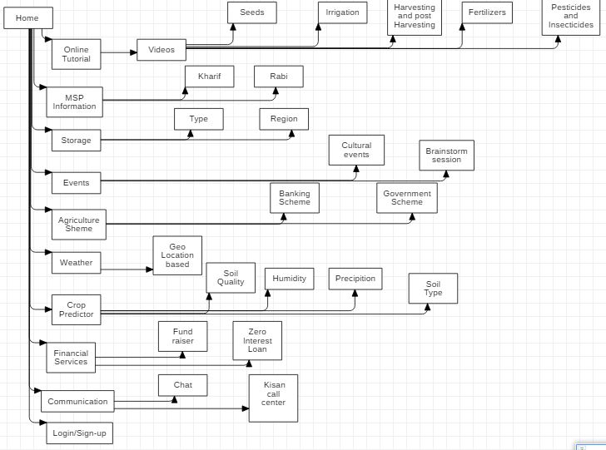

Slide 11
wireframes
Wireframes are a way to lay out information on the page.

Slide 12
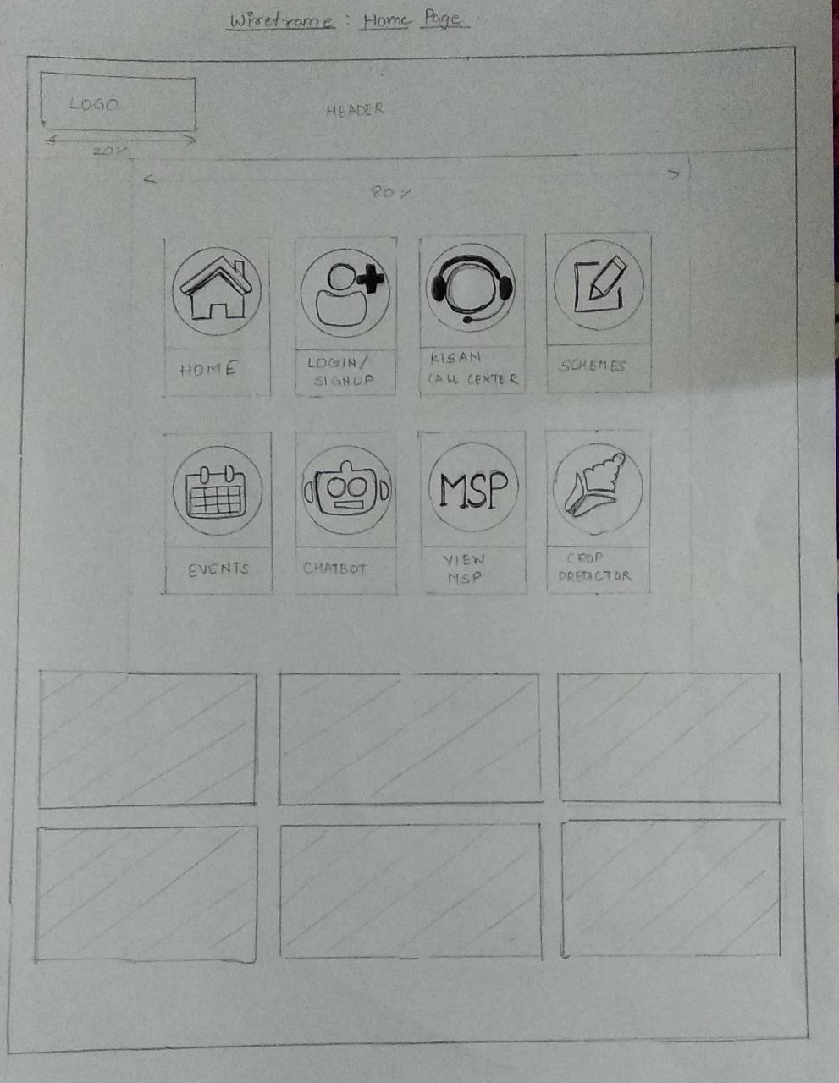

Slide 13
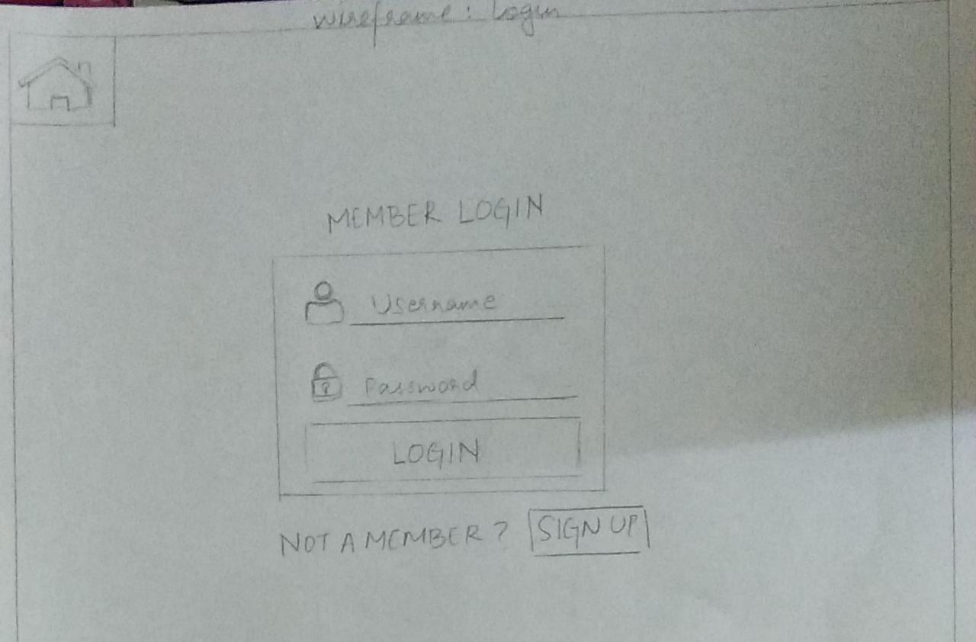

Slide 14
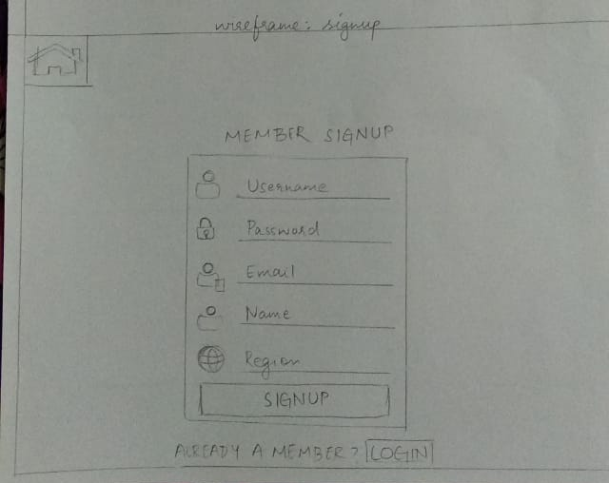

Slide 15
CHATBOT
Wireframes are a way to lay out information on the page.

Slide 16
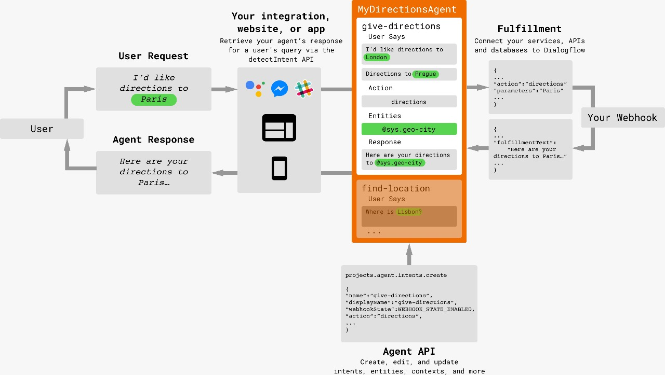

Slide 17
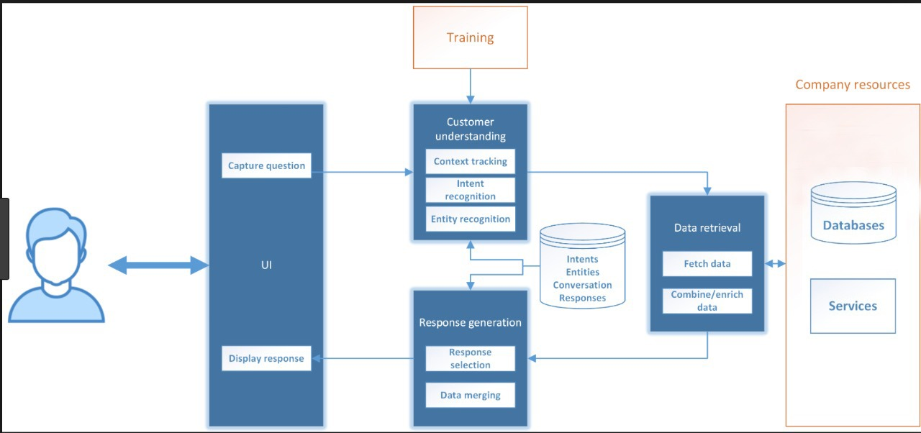

Slide 18
